Slide 1

Smart City: StopSpot
Brian Allen, Marcus Kwong, Tarun Singh, Hui-Yu Sim
Notes:
We are the smart city and for the last 3 weeks we’ve been working with C-tran on a project called StopSpot. Bruce presented the project to our class on slack, and our group seize the opportunity and take on the project

Slide 2

C-Tran’s Goal and Minimum Viable Product
Goal:
The goal of C-Tran is to improve the accuracy of static GPS positioning data of C-Tran transit stop using dynamic vehicle location data.
MVP:
A list ranking from worst to best accurate stops.
Stretch goal
Visualization tools
Notes:
So what’s the goal of the project?
The goal is to improve the accuracy of the static stop locations using the dynamic vehicle location data. C-Tran want to see how often are the vehicles stopping at the stop location. So if there is one specific stop that the vehicle is not stopping at, they might want to send some people to take a look at. Some reasons the vehicles are not stopping at the stop location could be branches are in the way or the increase activity of construction work.
Because we only had 3 weeks to work on the data, our MVP is to deliver a list of stops from worst to best accurate stops and a stretch goal of developing a visualization tool.

Slide 3

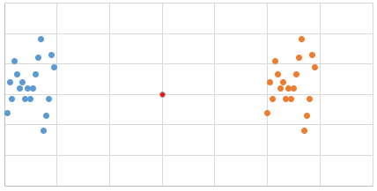
Analysis
What count as an accurate stop?
Finding percent error of each stop location using the dynamic vehicle location data
Each one of us did our own analysis and implementation
Data cleaning
Creating visualization
Notes:
Before our analysis we have to determine what count as an accurate stop. In the document provided by Bruce, it says that if the vehicle is stopping within 98ft of the stop location then it means that vehicle is stopping within the range and it is to be view as accurate. So, our group started thinking about type of analysis we can do. The first idea was to simply check that the average and median has to be below 98ft for it to be accurate. But then we thought of problem with that analysis is that if there are even number of time it stopped within 98ft and half stopping outside of 98ft. The 50% of time it is stopping within 98ft doesn’t seem correct to us. The second idea was to simply find the percent error of each stop location. Since the distance between the vehicle and stop location is already given to us in the dataset it’s easier to list out the stop from worst to best accuracy.
For our analysis process, we decided to work our own individual analysis and implementations. The reason behind it is because we want to make sure that our list match one another. When we finally came together to look at the result our percent error for the stop location did not match. The reason is because we all had different method of cleaning the data and some of us load in csv file which only takes 1.5mil rows and some of us use a database to load in all the data. However, our list from worst to best accurate stops were close with one another that we felt confident presenting the list to C-tran

Slide 4

End of two-week Sprint
Successfully deliver the list
Demo our visualization
Notes:
In our end of sprint meeting with David, we successfully deliver a list of worst to best accurate stops. Then we presented different type of visualization that our group developed and demo it to David. That lead to future development of this project and how for the next team can pick up where we left off.

Slide 5

Preprocessing : Decision Making
Restricting Attributes
Removal of excess attributes
Removal of Outliers
Null X & Y Coordinates
Multi-stops
Unscheduled/Temporary Stops
Schedule Status values 0, 1, 3

Slide 6
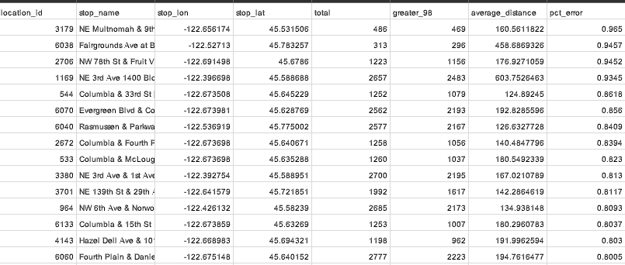
The Results: Tables and Graphs
Preprocessing Data for Analysis
Produce Results through SQL query
Use .csv file from SQL results for Visualization data

Slide 7
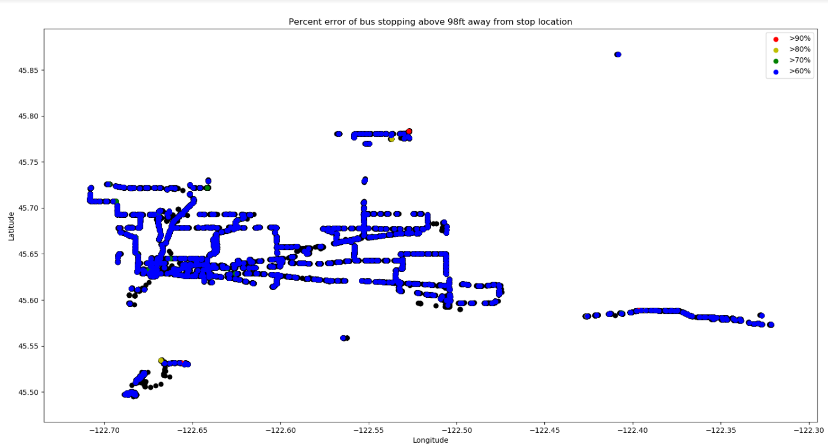

Slide 8
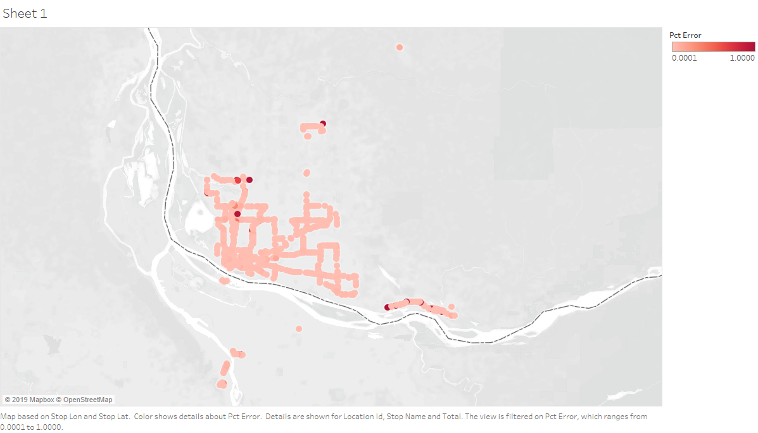
Percent error from 0.0001 to 1.0000 for all stops.

Slide 9
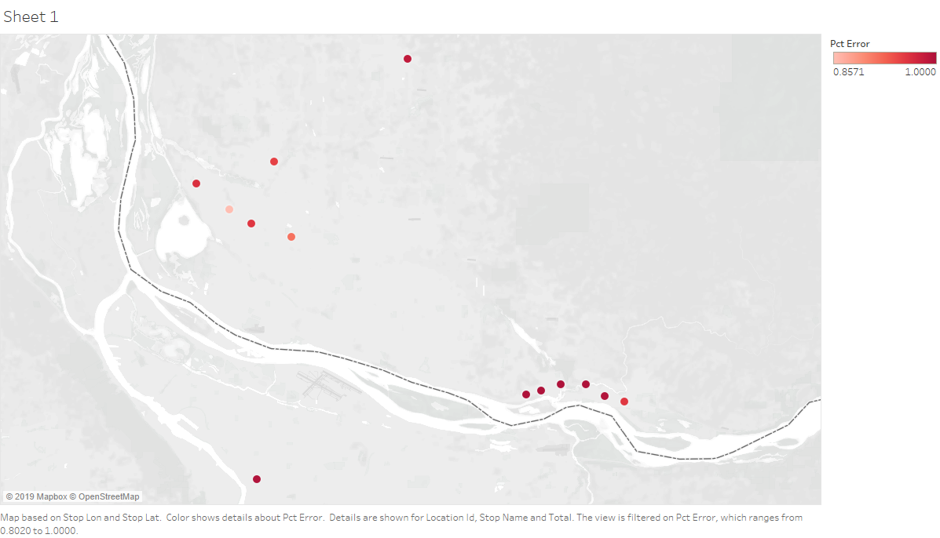
Percent error above 85%

Slide 10
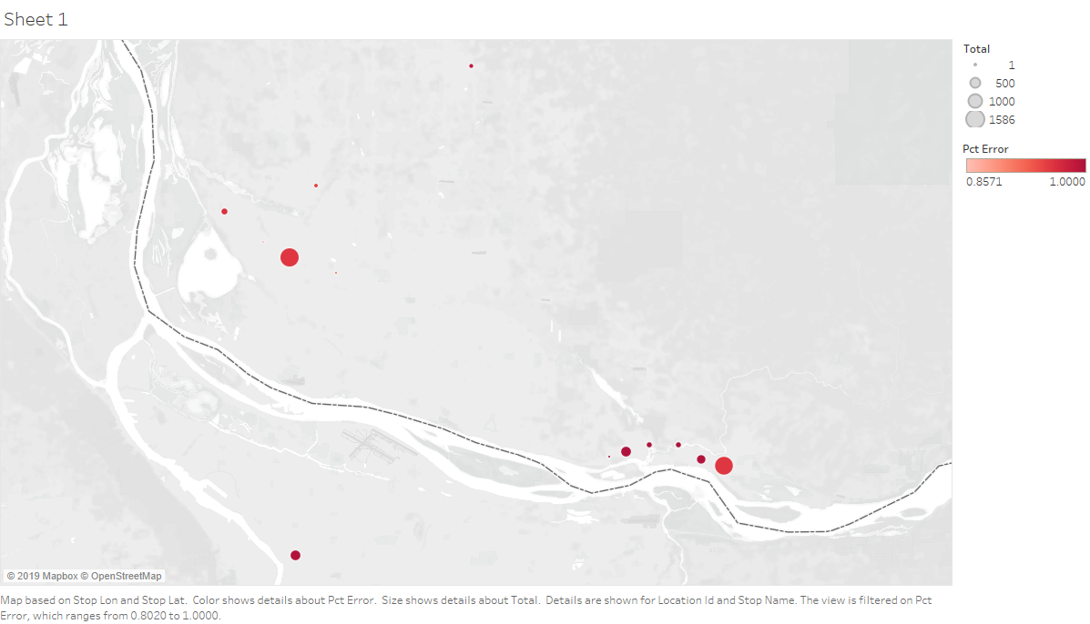
Filtering above 85% error with number of bus stopping iterations.

Slide 11
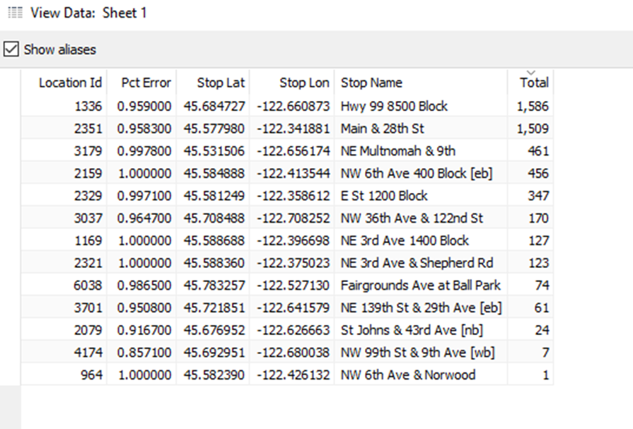
Data with filtering of 85% above error and number of bus stopping iterations.

Slide 12
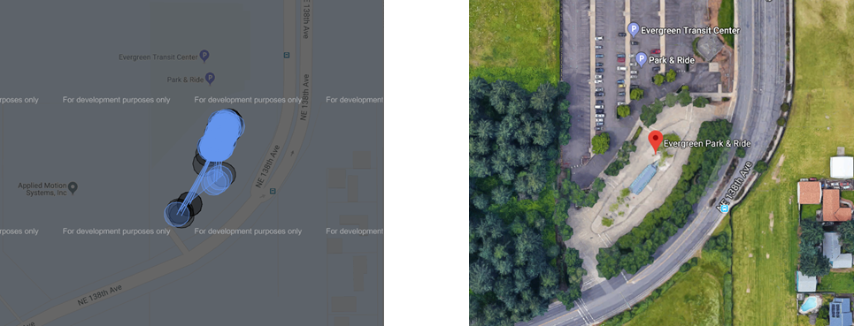
Graphical Results: The Good
Stop 102

Slide 13
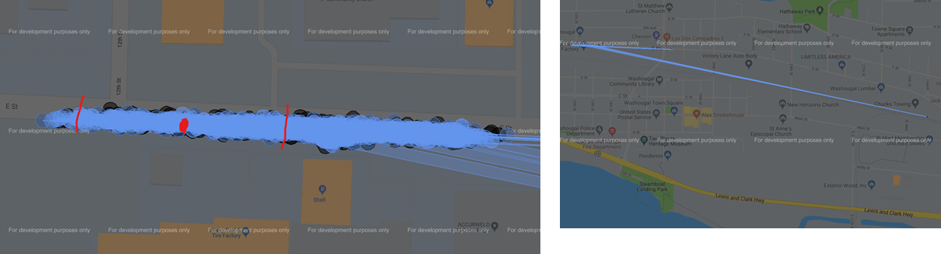
Graphical Results: The Bad
Stop 2329

Slide 14
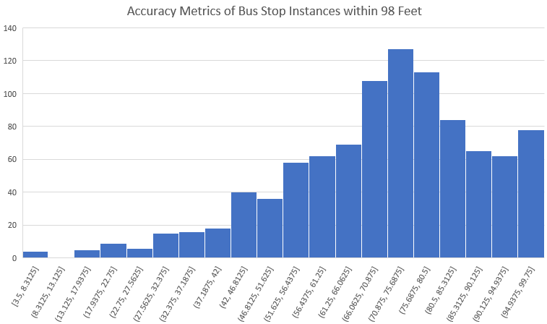

Slide 15
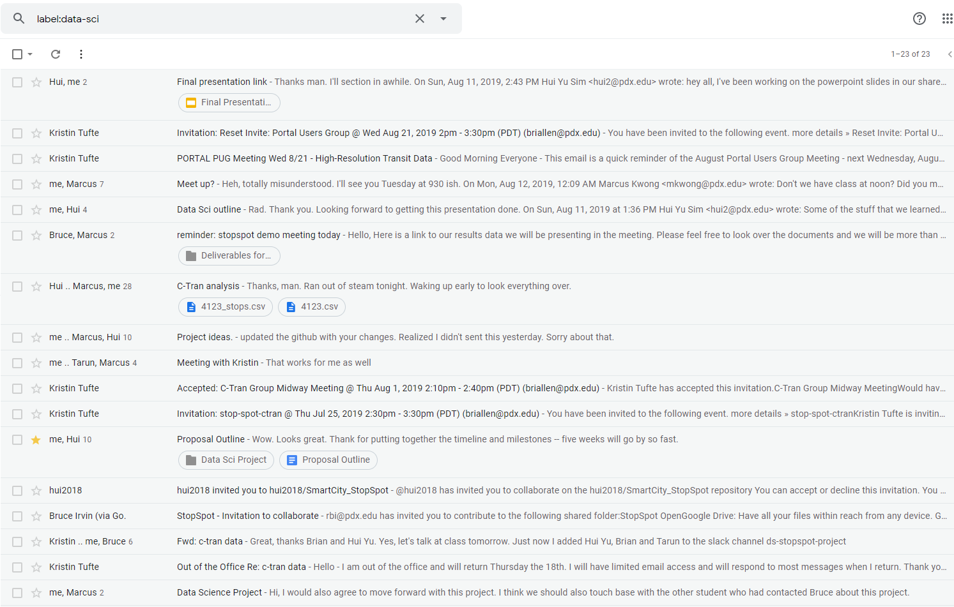
Data Wrangling
Trying to get the data
From PGE to C-Tran
Getting the actual data

Slide 16
Analysis Reflection
Writing queries vs writing code
Statistical analysis
Lazy spreadsheets
What do you mean we have different data?

Slide 17
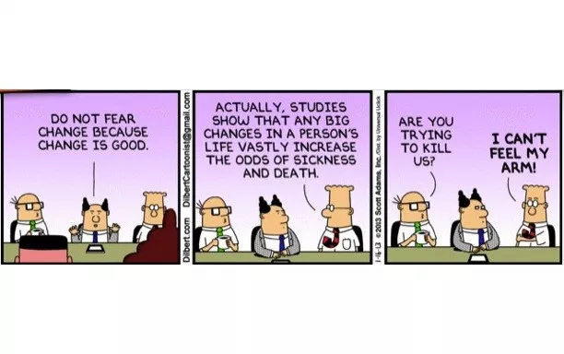
What we would change?

Slide 18

What would we change?
Our tech stack
Cleaning process
Better questions leads to better answers
Read the documentation then read it again.

Slide 19

Backlog
UI
Create a front end that can run a set of queries
Show highest percent error
At X ft away
Remove stops X away
With door flag on or off
Remove stops with less than X occurrences
Add “sliders” for accuracy of stops (David ask)
(Show all ←→ Only show highest error)
Create a front end that displays maps pins for a single stop
Create a front end that displays pins for all stops
Create a front end that can click on a stop to get single stop map
Create a front end that can be fed quarterly data and stop info for analysis
Backend
Choose and setup database
Choose framework to use to serve pages
Flask?
Django?
?
What Map package to use?

Slide 20
Backlog (cont)
Science
Looks for vehicles with consistent GPS issues
Double check accuracy of location_distance
Investigate geographic impacts on gps accuracy
Technical Debt
Create shared work space for Marcus and I
Docker on the cloud? PSU space?
New github?
Other
Create a mastery query that can clean and analyze data is one go
Just use python for analysis?
Flag for checked or accurate stops

